Slide 1
API Framework Using BDD Cucumber

Slide 2

Step1
Created Maven Project And Added Required Dependencies.
Dependencies Required:
Cucumber java
Cucumber Junit or TestNg
Rest Assured
Jackson data-bind

Slide 3
Step2
Creating Feature File
Feature file is nothing but Test Suite(Collection of Test cases).In Feature file Scenario’s Will be written.

Slide 4
Step3
Implementing Step Definition
A step definition class in Cucumber holds the test method and code which are mapped to the Gherkin test case steps on the feature file.

Slide 5
Step4
Implementing POJO Classes and Implementing Utils File
POJO(Plain Old Java Object) - It is an ordinary object, It increases the readability & re-usability of a Java program. And for serializing and deserializing Json payload.
UtilsFile - It is also used for Increasing the reusability of a java program.

Slide 6
Step5
Implementing RequestSpecfication, ResponseSpecfication, RequestSpecBuilder, ResponseSpecBuilder, and Response class

Slide 7
Step6
Implementing (.properties) file

Slide 8
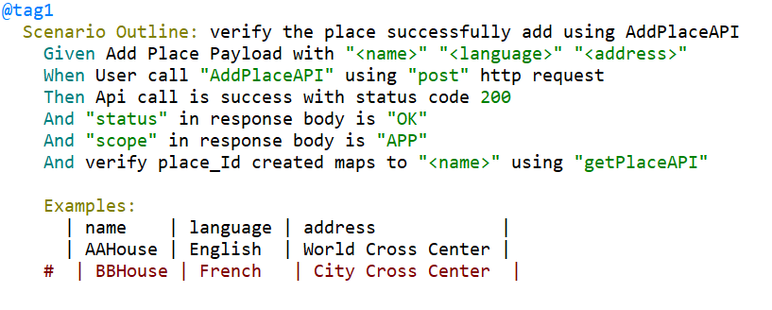
Step8
Implementing Data Driven Mechanism to drive data dynamically from feature file and parameterization to run tests with multiple data sets using cucumber “Example” keyword

Slide 9
Step9
Using Tagging Mechanism to run selected tests from Test Runner class

Slide 10
Step10
Implementing Pre and Post conditions for tests with cucumber Hooks.

Slide 11
Step 11
Executing the project from the command prompt by using maven commands
1.mvn compile
2.mvn test
3.mvn test –Dcucumber.options=“—tags @tag”
4.mvn test –Dcucumber.features=“path” –Dbrowser=firefox

Slide 12
Step 12
Executing the project from the run configuration in eclipse
1.compile
2.test
3.test –Dcucumber.options=“—tags @tag”
4.test –Dcucumber.features=“path” –Dbrowser=firefox

